Slide 1
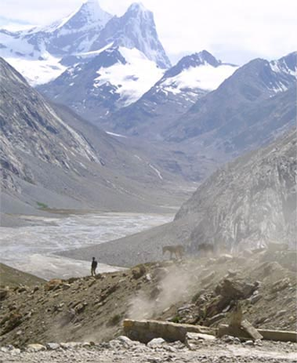
Fellowship of the Heart
Getting Started — the Four Connects, walked around the table on alternating evenings
Evening Series 2026–27 · at the Tittle home · v1.5E DRAFT
All Scripture: ESV · The Companion lesson plans carry the full scripts — these slides carry the room
1
Notes:
DECK TITLE · pre-session · DIVIDER
On screen as the room assembles on night one. All Scripture ESV; the plans carry the scripts; these slides carry the room — and these notes carry you.

Slide 2

SESSION 18
The Return II
A lighter homecoming — the room knows the way now, and the year begins to hand itself over
Quarter 4: Consolidation & Sending
220
Notes:
S18 · pre-session · DIVIDER
On screen through dinner and as the circle forms. Greet at the door — the slide holds the room. Name tags out one more time; the year's last re-entry gets the same welcome as its first. Doors close at 7:00 and a Companion-in-Formation opens.

Slide 3

Session 18 — Tonight’s Road
1 Opening container
2 Not growing weary — Gal. 6:9, Phil. 1:6
3 “What held” — the whole room
4 The final stretch — the map
5 Homework commissioning — handout + check-in partners
6 Closing container
7 Leader Feedback Round
8 Aaronic blessing and sending
221
Notes:
S18 · 7:00–8:30 · LEAD: BOTH LEADERS CIRCLE
BEATS:
1. Frame the night light: Return II, not Return I — the room knows how to come back now; say it out loud and let the session prove it.
2. Walk the road: teen-led open, two verses, a one-sentence what-held round, the final-stretch map, practice, close.
3. One circle all night — no pairing.
GUARD: A light night still gets a full listening — read every check-in word closely; the break may have been hard in some house. Section 6 and the two-adult rule hold today as every night.

Slide 4
Opening Container — the Eight Steps
1 Welcome — five minutes to open the container
2 Phones silenced and put away
3 Stand in a circle
4 One-word check-in — how you actually are, right now
5 Put out / bring in — set something down; bring a blessing in
6 Spoken commitment: “I am here. I am paying attention. I am willing to be moved.”
7 Opening prayer — “Holy Spirit, you are welcome here. Speak. We are listening.”
8 Sit. Begin.
222
Notes:
S18 · 7:00–7:08 · LEAD: CONTAINER HOLDER CIRCLE
BEATS:
1. The Companion-in-Formation runs the full eight steps from memory, normal pace — nothing changes because a teen holds it; that is the point.
2. Sit where the teen can find your eyes; otherwise stay out of the way.
3. Receive every check-in word; the adults read them as closely as ever.
CUES: Timing Companion starts discreetly at 7:00 and notes the minute the room is truly present — expect it fast; the speed is the year's work showing, and it goes in the log.
GUARD: Do not shadow the open or add a welcome on top of the teen's — over-carrying teaches the room it still needs carrying.

Slide 5
Not Growing Weary — Galatians 6:9 and Philippians 1:6
• At the Rhythm week this verse was a warning; tonight, on the far side of a break, it is a receipt — you did not give up. You are here
– “And I am sure of this, that he who began a good work in you will bring it to completion at the day of Jesus Christ.” — Philippians 1:6 (ESV)
• The not-giving-up is not white-knuckling: the work being completed in you is His. He began it; He finishes it
• “Our rhythm is not the engine — it is the showing-up that keeps us where the engine is running.”
• The last re-entry of the year — look how fast the room came back. That is what it looks like when the practices start belonging to you
GALATIANS 6:9 (ESV)
“And let us not grow weary of doing good, for in due season we will reap, if we do not give up.”
223
Notes:
S18 · 7:25–7:33 · LEAD: CONTENT PRESENTER CIRCLE
BEATS:
1. Read Galatians 6:9 then Philippians 1:6 aloud from the physical Bible. Brief — the room already owns the first verse.
2. Teach: at the Rhythm week the verse was a warning; today it is a receipt — the chair they are sitting in is the not-giving-up it asks for.
3. Phil 1:6 names why it is not white-knuckling: He began the work; He finishes it; the rhythm just keeps us where the engine runs.
4. Land the observation: last re-entry of the year — look how fast the room came back; the practices belong to them now.

Slide 6

“What Held” — the Whole Room
• One sentence each, full circle — a harvest reading, not an examination
• “What held from your card across the break — or what slipped and got begun again?”
• Holds and slips are both good news tonight — both mean the card is real and you are reading it honestly
• A parent starts; brisk and warm; pass-anytime holds — laughter is allowed and likely
– “In September that round would have taken an hour and a crowbar. The practices are yours now.”
“When your children ask their fathers in times to come, ‘What do these stones mean?’”
— JOSHUA 4:21 (ESV)
224
Notes:
S18 · 7:33–8:01 · LEAD: CONTENT PRESENTER CIRCLE
BEATS:
1. One sentence each, full circle: what held from your Rhythm Card across the break — or what slipped and got begun again.
2. Keep it brisk and celebratory — a harvest reading, not an examination; holds and slips are both good news; laughter is allowed and likely.
3. If a sentence becomes a story, receive warmly and keep the circle turning.
4. Close: the room just read itself in one pass, nobody coaxed — best finding of the year; and Joshua's question is about to change hands.
CUES: The arranged parent (Run Card) gives the first sentence — never a cold call on a teen. A Companion quietly tallies how many reported a daily practice holding — numbers only, no names.
GUARD: A slip that sounds like a hard break, not a busy one — nearest Companion notes it and follows up at the door; the round does not stop.

Slide 7
The Final Stretch — the Map
1 Week 19 — our Companions-in-Formation teach the two mercy cards — the Signs Card and the Path Home Card — in your pairs
2 Week 20 — The Long Walk: the seniors teach the whole room; journals come along, and the testimony gathering begins
3 Week 21 — Sending and Blessing: whole families, a longer evening — two hours, 4:15 to 6:15
4 Week 22 — the Commissioning of the Companions, in front of everybody who watched them grow
• Hear the shape of that list: week by week, the people up front stop being us and start being you
• The sentence to keep: “the year now begins to hand itself over”
225
Notes:
S18 · 8:01–8:20 · LEAD: CONTENT PRESENTER CIRCLE
BEATS:
1. Write the five lines live on the whiteboard, saying each: Wk 19 the teens teach the two mercy cards in pairs; Wk 20 The Long Walk — the seniors teach the whole room, journals come; Wk 21 Sending and Blessing — whole families, a TWO-HOUR night; Wk 22 the Commissioning of the Companions.
2. Land the frame sentence: the year now begins to hand itself over — that was always the plan.
3. Three asks: come, bring your journal, bring the whole family to Week 21 — calendar it today, date visible on the board.
CUES: This script carries the school clock for Session 21, but the Week 21 plan runs food 6:00, session 6:30–5:30 — confirm the times in the family email before announcing.
GUARD: Watch the teens both ways — seniors hearing their commissioning named get a word of honor at the door; the teen who feels the ending gets warmth this week, not correction today.

Slide 8

Homework — Two Weeks, Four Parts
• Run your Rhythm Card as built — nothing new, nothing extra; if the break knocked a piece loose, begin again on the next available day
• The evening note, one extra flavor: note where you see God already handing pieces of this year over to you
• For the parents, said once: the Four Questions door is still open — willing-only, whenever the moment is right; nobody will ever check. The questions keep
• Bring your journal — and put Week 21's two hours on the calendar tonight
226
Notes:
S18 · 8:20–8:24 · LEAD: CONTENT PRESENTER CIRCLE
BEATS:
1. Co-Companion (Parent) leads: run the Rhythm Card as built — nothing new; if the break knocked a piece loose, begin again on the next available day.
2. Evening-note flavor this week: note where you see God already handing pieces of the year over to you.
3. The Four Questions word to parents — one paragraph, spoken to the middle distance, moved past without pausing for reaction: willing-only, not-yet counts, nobody checks.
GUARD: It is a door left ajar, not a knock. If any parent looks cornered, repeat the guards 1:1 before they leave; whatever they say afterward, receive, encourage, audit nothing.

Slide 9
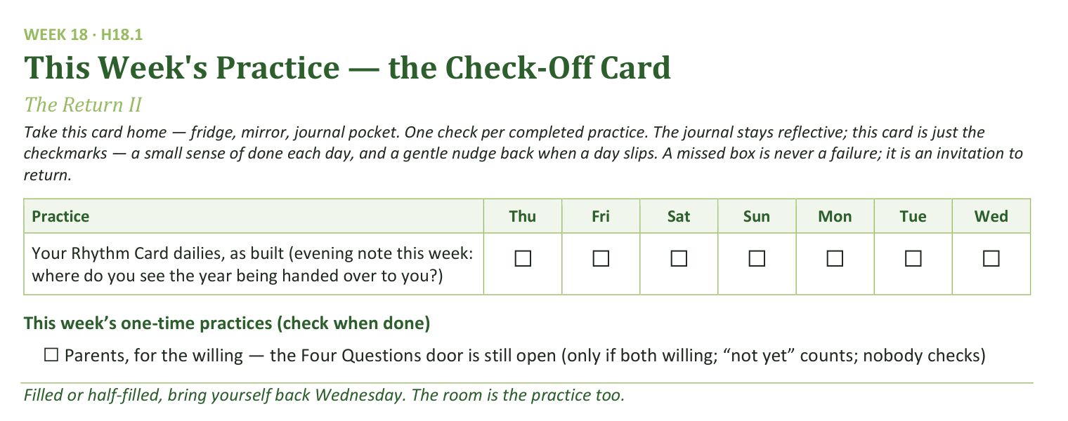
Your Take-Home Card — This Session’s Practice
Handed out now — fridge, mirror, journal pocket.
227
Notes:
S18 · 8:20–8:24 · LEAD: CONTENT PRESENTER CIRCLE
BEATS:
1. Hold up the check-off card (H18.1): one daily row — the Rhythm Card dailies as built, with this week's evening-note question.
2. One one-time box: the Four Questions door, willing parents only.
3. Say the card's own rule: a missed box is never a failure; it is an invitation to return.

Slide 10
Closing the Container + Aaronic Blessing
• We close the way we opened — the container, six steps:
1 Stand again — same circle, same posture as the open
2 One-word landing — compare it to your opening word
3 The one thing you are taking from tonight
4 The one practice — committed aloud, or modified to one you will actually keep
5 Blessings — specific, witnessed, short
6 Closing prayer — and the Aaronic blessing, spoken over each other, face to face
THE AARONIC BLESSING — NUMBERS 6:24–26
“The Lord bless you and keep you;
the Lord make his face to shine upon you, and be gracious to you;
the Lord lift up his countenance upon you, and give you peace.”
228
Notes:
S18 · 8:28–8:30 · LEAD: CONTAINER HOLDER CIRCLE
BEATS:
1. The Companion-in-Formation runs closing steps 1–5: stand; one-word landing (compare to the opening word — the contrast is data); the one thing; the one practice (the card, as built); the blessings.
2. Expect the blessings step to lean toward the seniors today — let it.
3. Hold the Aaronic blessing — today it comes AFTER the feedback round, on the final slide.
CUES: Blessing form = one short, specific, witnessed sentence of what someone saw the Father doing in another person today — not a speech.

Slide 11
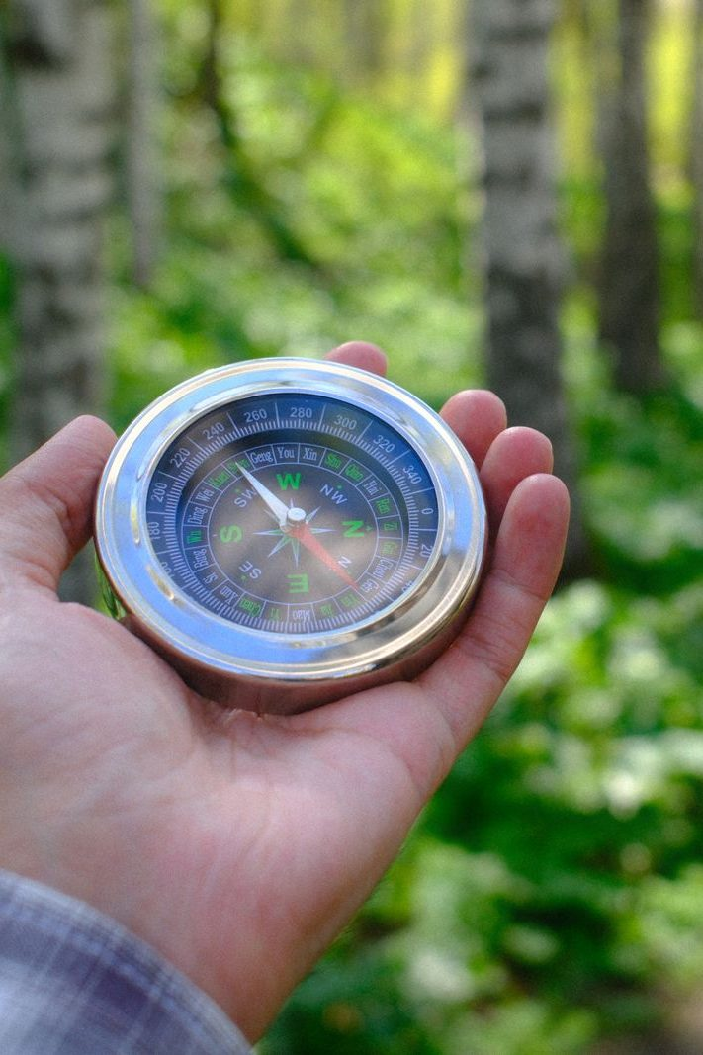
The Leader Feedback Round
• Two rounds, same as every session — the container holder first, then the content presenter: three things each
– “What I think went well tonight: ______”
– “What I’d do differently next time: ______”
– “If I were to teach tonight’s process to someone, I would tell them: ______”
• Then the room — the same two questions about tonight
• The leaders receive without defending — “thank you” is the whole response
229
Notes:
S18 · 8:24–8:28 · LEAD: BOTH LEADERS CIRCLE
BEATS:
1. The teen who led answers first: what went well, what I'd do differently, what I'd tell someone teaching today's process.
2. The Lead Companion answers the first two, briefly, for the blocks they carried.
3. Then the room — same two questions; two or three voices each; leaders receive without defending — 'thank you' is the whole response.
CUES: The round may be dropped if the room's energy needs something else; dropping it twice running goes to the team debrief.

Slide 12
Aaronic Blessing and Sending
• “One sentence for the road: you came back tonight like people who know the way — because you do now.”
• “Five weeks to the sending. Let us not grow weary; the season is His, and it is nearly harvest.”
• “See you Wednesday. Week 19 — the teens have the cards.”
NUMBERS 6:24–26
“The Lord bless you and keep you; the Lord make His face shine on you and be gracious to you; the Lord turn His face toward you and give you peace.”
230
Notes:
S18 · 8:28–8:30 · LEAD: CONTAINER HOLDER CIRCLE
BEATS:
1. One sentence for the road: you came back like people who know the way — five weeks to the sending; the season is His, and it is nearly harvest.
2. Speak the Aaronic blessing (Numbers 6:24–26), hands up if you want.
3. Send them glad: see you evenings — Week 19, the teens have the cards.

